Slide 1
Distributed systems and Cloud Computing
Lecture 1

Slide 2
We will very likely cover topics such as
MPI - Message Passing Interface
Actor Model for Distributed Programming
Apache Spark
Amazon AWS
Google Cloud
Microsoft Azure

Slide 3
Introduction to Distributed Systems

Slide 4
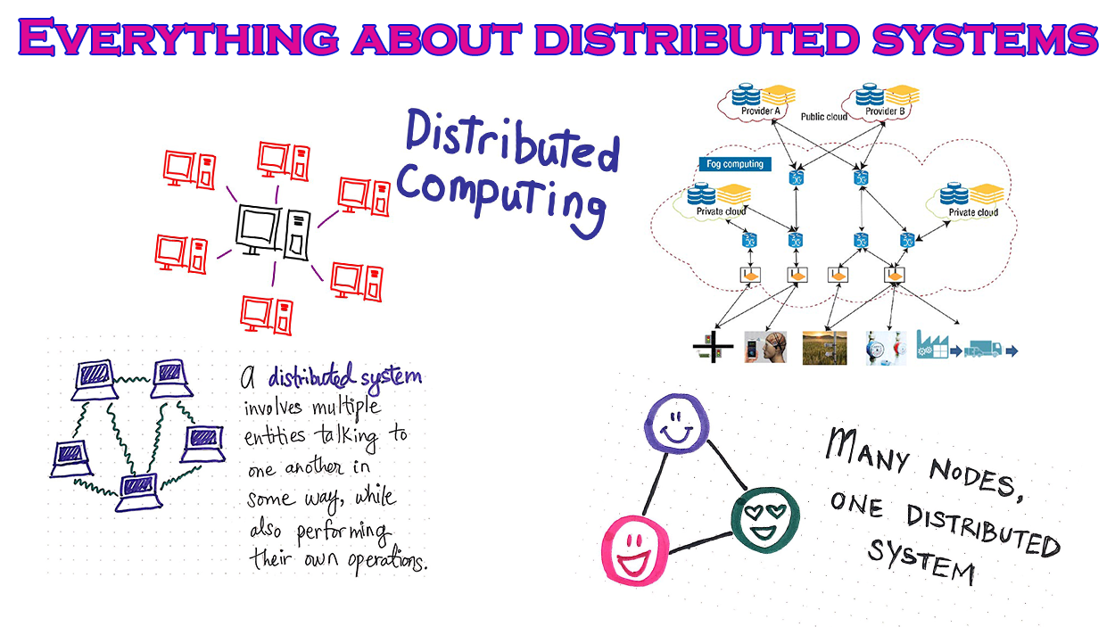

Slide 5
What is Distributed Systems?
Also known as distributed computing and distributed databases, a distributed system is a collection of independent components located on different machines that share messages with each other in order to achieve common goals. Distributed computing is the method of making multiple computers work together to solve a common problem.

Slide 6
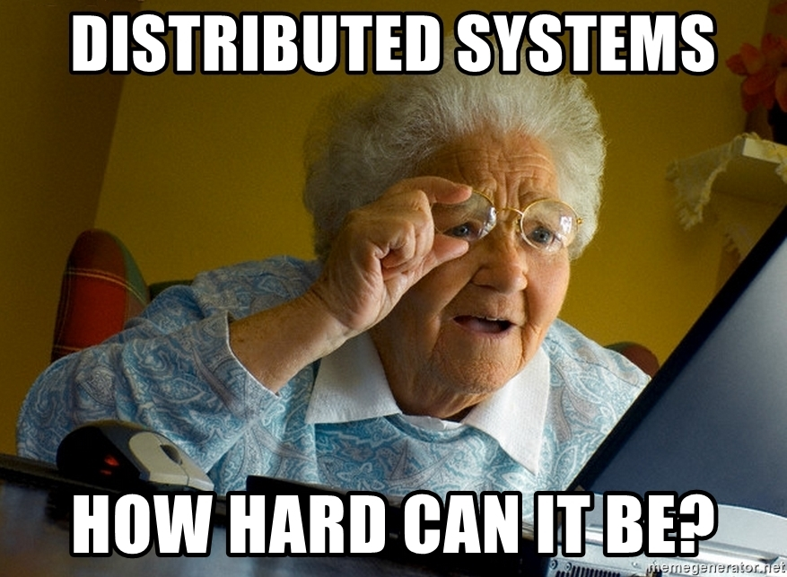

Slide 7
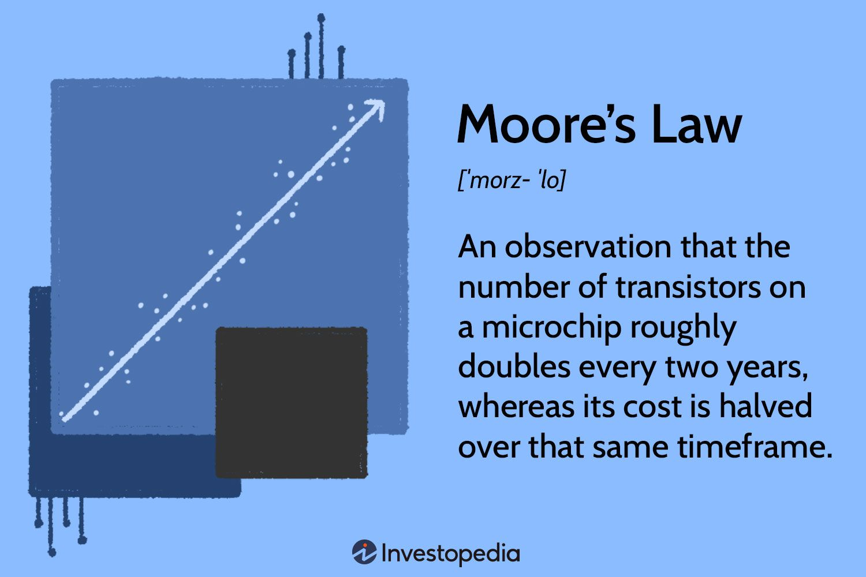

Slide 8
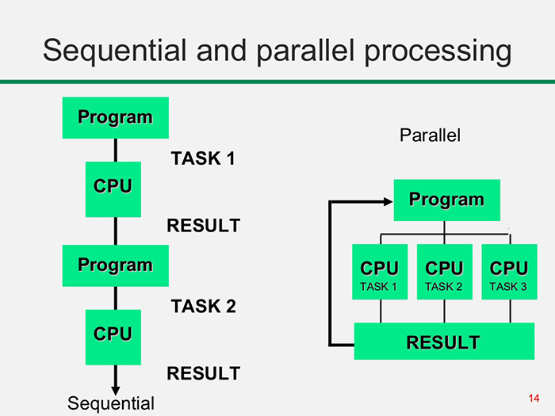

Slide 9
Parallelism is the new order of the day

Slide 10
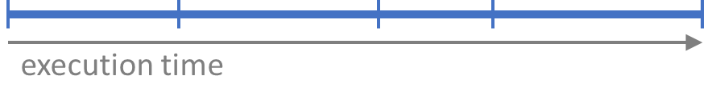
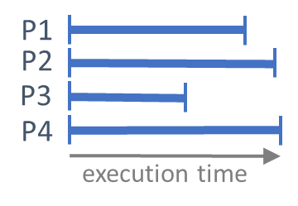
Advantages of Parallel computing
Serial implementation
Parallel implementation

Slide 11
Evolution of Distributed Systems

Slide 12
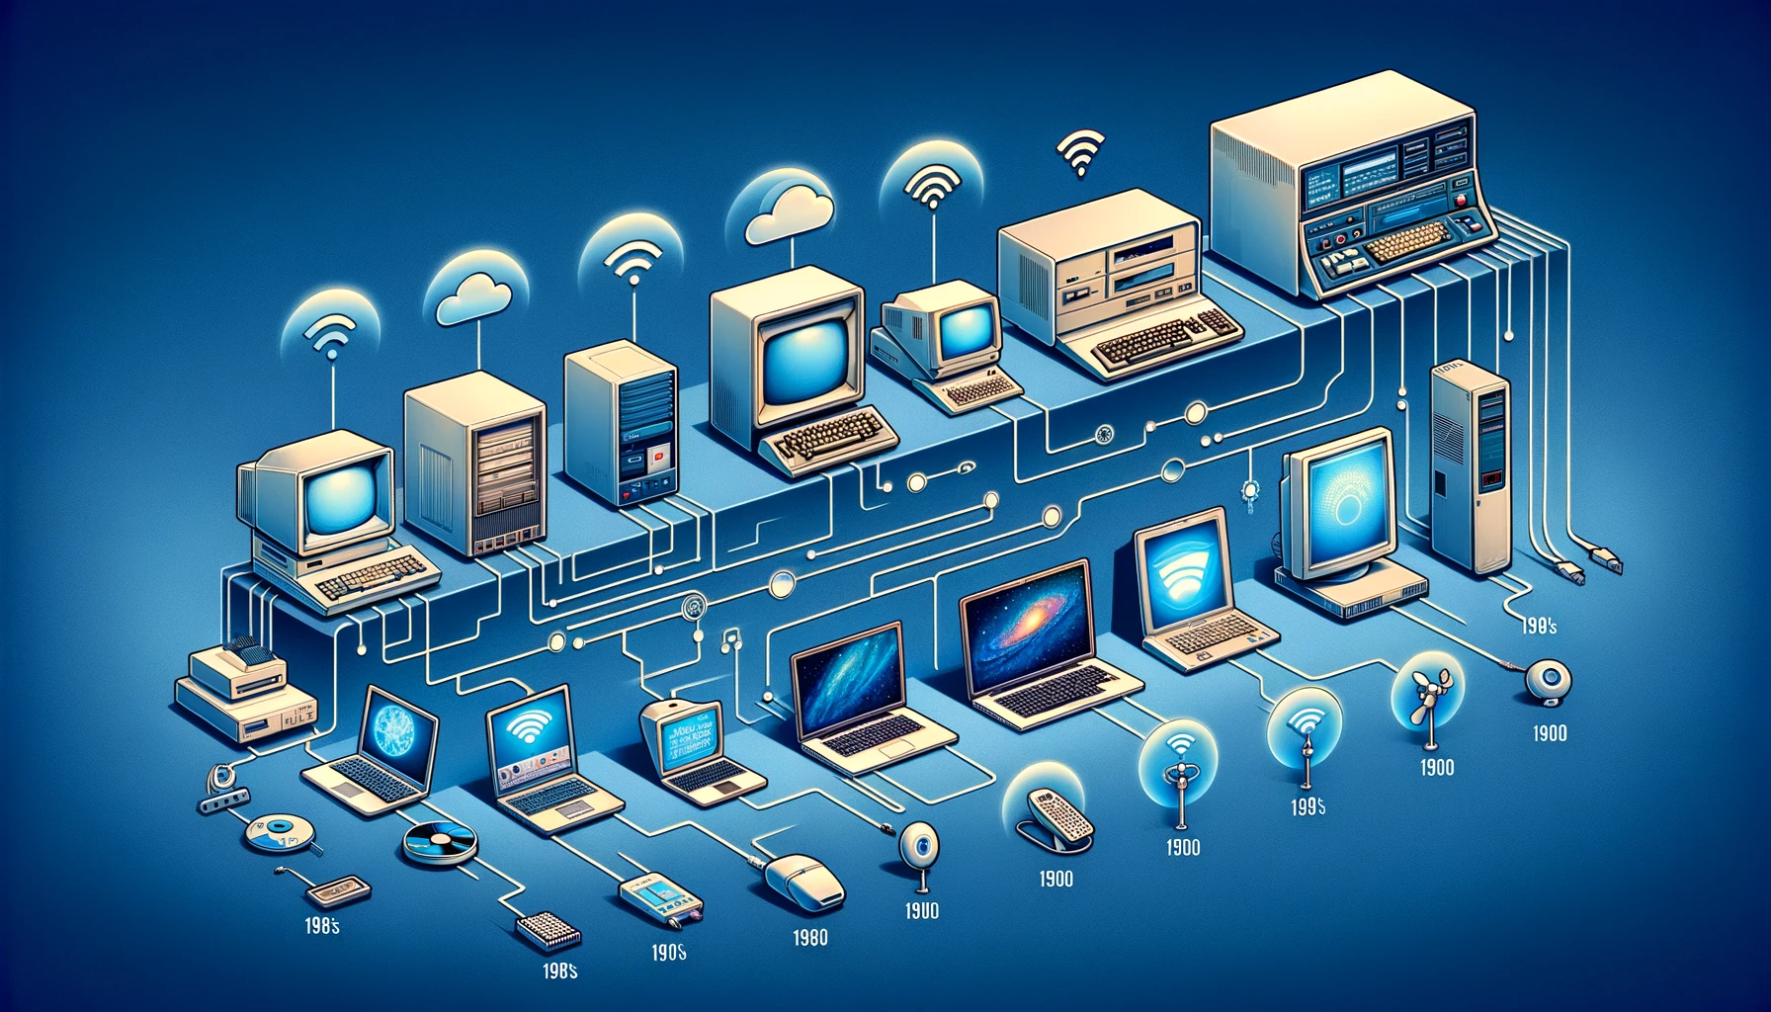
The Birth of Networking
In the early days, computers operated in isolation. The birth of networking marked a transformative era as machines started connecting for basic communication. This allowed data exchange and paved the way for collaborative computing.
From Isolated Machines to Connected Worlds

Slide 13
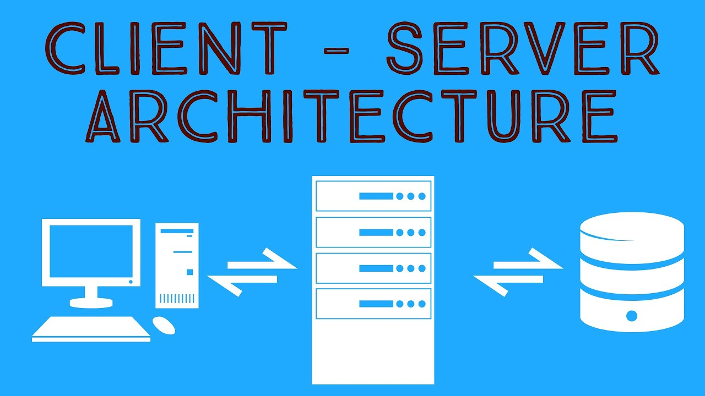
Client-Server Architecture
The client-server architecture emerged, introducing a centralized model where clients requested services from a central server.
This paradigm shift streamlined processes, making information and services more accessible across networks.
Enter the Client-Server Era

Slide 14

Proliferation of the Internet
With the proliferation of the internet, distributed systems became ubiquitous. Mass adoption occurred, connecting the world in ways previously unimaginable.
This global network laid the foundation for distributed computing on a larger scale.
The Web Unleashed

Slide 15

Peer-to-Peer Networks
Peer-to-peer networks gained prominence, promoting decentralization. Devices began sharing resources directly, reducing reliance on a central authority. This shift brought about increased resilience and scalability.
The Rise of Equality

Slide 16

Distributed Computing
The era of distributed computing began, leveraging the collective power of multiple machines. Tasks were divided and processed in parallel, optimizing performance and efficiency.
Harnessing Collective Power

Slide 17
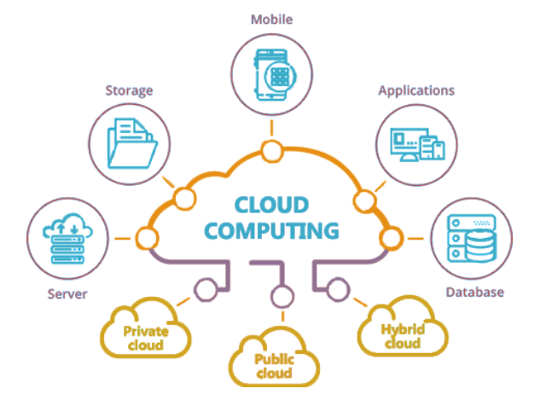
Cloud Computing Emerges
Cloud computing revolutionized the landscape by introducing virtualization. This allowed remote access to computing resources on-demand, offering scalability, flexibility, and cost-efficiency.
The Sky's the Limit

Slide 18
Elements of a Distributed System
The most important functions of distributed computing are:
Resource sharing - whether it’s the hardware, software or data that can be shared
Openness - how open is the software designed to be developed and shared with each other
Concurrency - multiple machines can process the same function at the same time
Scalability - how do the computing and processing capabilities multiply when extended to many machines
Fault tolerance - how easy and quickly can failures in parts of the system be detected and recovered
Transparency - how much access does one node have to locate and communicate with other nodes in the system.

Slide 19
Different ways to achieve Distributed computing?
Distributed computing involves the use of multiple computers or servers to work together on solving a problem or executing a task.
There are several ways to achieve distributed computing, each with its own advantages and use cases.
Here are some common approaches:

Slide 20
Client-Server Architecture
2. Peer-to-Peer Networks
3. Distributed Computing Clusters
Description: In this model, one central server provides services or resources, and multiple client machines request and use these services.
Use Case: Common in applications where centralized control is needed, such as web servers or database systems.
Description: In a peer-to-peer network, all nodes (computers or devices) are considered equal, and they can share resources directly with one another without relying on a central server.
Use Case: Popular for file sharing (e.g., BitTorrent) and decentralized applications.
Description: Multiple computers are interconnected and work together as a cluster. Tasks are divided among the cluster nodes, allowing parallel processing and improved performance.
Use Case: High-performance computing tasks like scientific simulations or data analysis.

Slide 21
4. Grid Computing
5. Distributed Databases
6. Cloud Computing
Description: Similar to clusters, but often involves geographically distributed resources connected over a network. It aims to solve large-scale problems by utilizing idle resources from multiple locations.
Use Case: Research projects, scientific computing, and projects that require massive computational power.
Description: Data is distributed across multiple nodes, allowing for improved scalability and fault tolerance. Different types include sharded databases and NoSQL databases.
Use Case: Large-scale applications with high read and write demands, such as social media platforms.
Description: Resources are provided as a service over the internet. Users can access computing power, storage, and other services on a pay-as-you-go basis.
Use Case: General-purpose computing, scalable web applications, and data storage.

Slide 22
Distributed Computing Models
Message Passing Model
Actor Model

Slide 23
The Message-Passing Model
Based on the notion of multiple processes
A process is an instance of a running program, together with the program’s data
Parallelism is achieved by having many processes co-operate on the same task
Each process has access only to its own data
all variables are private
Processes communicate with each other by sending and receiving messages
using library calls from a conventional sequential language for synchronization
sending data from one process's memory space to another

Slide 24
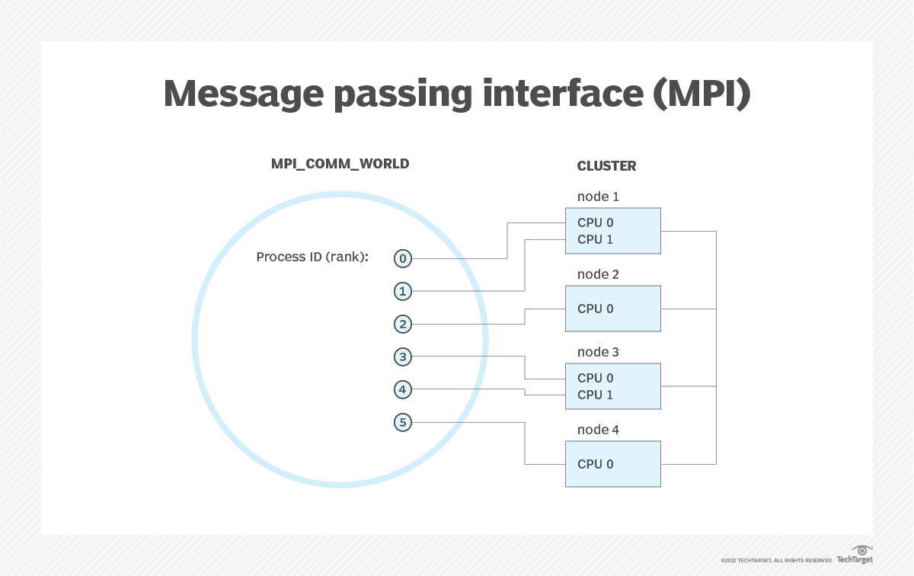
MPI: Message Passing Interface
The message passing interface (MPI) is a standardized means of exchanging messages between multiple computers running a parallel program across distributed memory.
MPI is not…
a language or compiler specification
a specific implementation or product

Slide 25
Reasons for Using MPI
Standardization: MPI has replaced other message passing libraries, becoming a generally accepted industry standard.
Portability: MPI has been implemented for many distributed memory architectures, meaning users don't need to modify source code when porting applications over to different platforms that are supported by the MPI standard.
Speed: Implementation is typically optimized for the hardware the MPI runs on. Vendor implementations may also be optimized for native hardware features.
Functionality: MPI is designed for high performance on massively parallel machines and clusters. The basic MPI-1 implementation has more than 100 defined routines.
Availability: A variety of implementations are available, both commercial and public domain
OpenMPI and MPICH are popular open-source and free implementations of MPI
Microsoft has an open source implementation for Windows called MSMPI

Slide 26
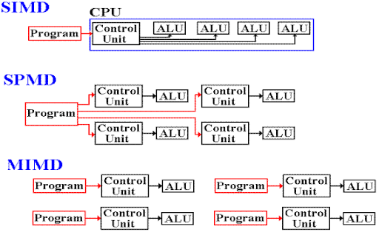
SIMD / SPMD
Most message passing programming systems use the Single-Instruction-Multiple-Data (SIMD)
Sometimes is this also called SPMD: Single Program Multiple Data
All processes run their own identical copy of the same program
Each process work on different parts of same data or on different data
Each process has a unique identifier
Processes can follow different control paths through the program, depending on their process ID
Usually run one process per processor / core / machine

Slide 27
Communication Messages
A message usually transfers a number of data items of a certain type from the memory of one process to the memory of another process
A message typically contains
the ID of the sending process
the ID of the receiving process
the type of the data items
the number of data items
the data itself
a message type identifier
Sending a message can either be synchronous or asynchronous
A synchronous send is not completed until the message has started to be received
An asynchronous send completes as soon as the message has been accepted into the system
Receives are usually synchronous - the receiving process must wait until the message arrives

Slide 28
Process Identification
MPI processes can belong to one or more groups called "communicators" (communication channels)
Processes within a communicator can only communicate with other processes in that communicator
When an MPI application starts, the group of all processes is initially given a predefined name called MPI_COMM_WORLD
A process is identified by a unique number within each communicator, called rank
The process of rank zero (0), is the starting process or the first process. In older documentation, it is refer to as the "master" node. Other documentation may refer to it as "controller" node or "supervisor" node.
For two different communicators, the same process can have two different ranks: so the meaning of a “rank” is only defined when you specify the communicator

Slide 29
Data Communication
Data communication in MPI is like email exchange
One process sends a copy of the data to another process, and the other process receives it
Communication requires the following information:
Sender has to know:
Who to send the data to (receiver’s process rank)
What kind of data to send (100 integers or 200 characters, etc)
A user-defined “tag” for the message (like an email subject which allows the receiver to understand what type of data is being received)
Receiver might have to know:
Who is sending the data. It's OK if the receiver does not know; in this case sender rank will be MPI_ANY_SOURCE, meaning anyone can send
What kind of data is being received
What the user-defined “tag” of the message is. It's OK if the receiver does not know; in this case tag will be MPI_ANY_TAG

Slide 30
Using Ranks for Communication
When sending data, the sender has to specify the destination process’ rank (process ID)
specifies where the message should go
The receiver has to specify the source process’ rank
indicates where the message will come from
The ID of MPI_ANY_SOURCE is a special “wild-card” source ID that can be used by the receiver to match any source

Slide 31
Point to Point Messaging
Sender calls a SEND routine
specifying the data that is to be sent
this is called the send buffer
Receiver calls a RECEIVE routine
specifying where the incoming data should be stored
this is called the receive buffer
Data goes into the receive buffer
Metadata describing message also transferred
this is received into separate storage
this is called the status

Slide 32
MPI Basic Send Message
MPI_SEND(buf,count,datatype,dest,tag,comm)
The message buffer is described by buf, count, datatype.
The target process is specified by dest and comm.
dest is the rank of the target process in the communicator specified by comm.
tag is a user-defined “type” for the message
When this function returns, the data has been delivered to the system and the buffer can be reused.
Thus this function is "blocking"
However, the message might not have been received by the target process, yet.

Slide 33
MPI Basic Receive Message
MPI_RECV(buf,count,datatype,source,tag,comm,status)
Waits until a matching on source, tag, comm message is received from the system, and the buf buffer can be read.
source is rank in communicator comm, or MPI_ANY_SOURCE.
Receiving fewer than count occurrences of datatype is OK, but receiving more is an error.
status is a structure containing further information:
Who sent the message, which is useful if you used MPI_ANY_SOURCE
How much data was actually received
What tag was used with the message, which is useful if you used MPI_ANY_TAG
MPI_STATUS_IGNORE can be used if we don’t need any additional information

Slide 34
Running MPI Programs
MPI programs can either run on the same computer or they can be distributed to other computers(nodes) to share the workload.
In order to run MPI programs on other nodes, they have to be copied to all the node.

Slide 35
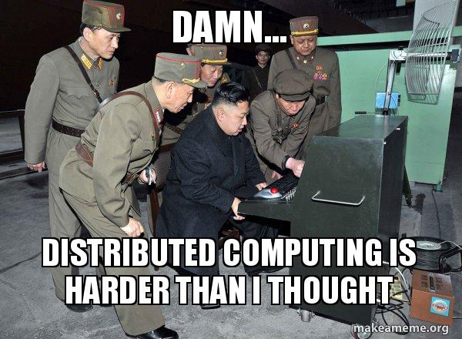

Slide 36
Assessment
This assessment is a Portfolio for 5CS022 Distributed and Cloud Systems Programming, which accounts for 100% of the module marks.
There are several components to the Portfolio:
Part 1 – Workshop tasks
The workshop tasks will contribute 20% of the marks to the Portfolio. These
will be clearly identified within the workshop instructions.
Part 2 – Quizzes
Quiz will contribute a total of 30% of the marks to the Portfolio.
Part 3 – Coursework
The coursework will consist of a number of questions that you will have to answer by writing a short
research-based report and a number of tasks which you will have to carry out by creating a number
of specified programs. The coursework will contribute 50% of the marks to the Portfolio.

